Slide 1
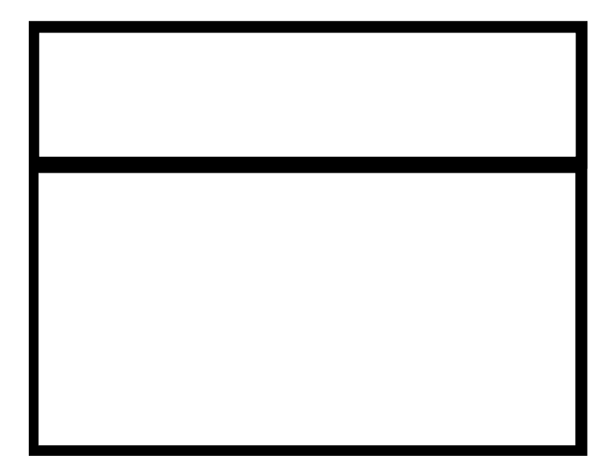

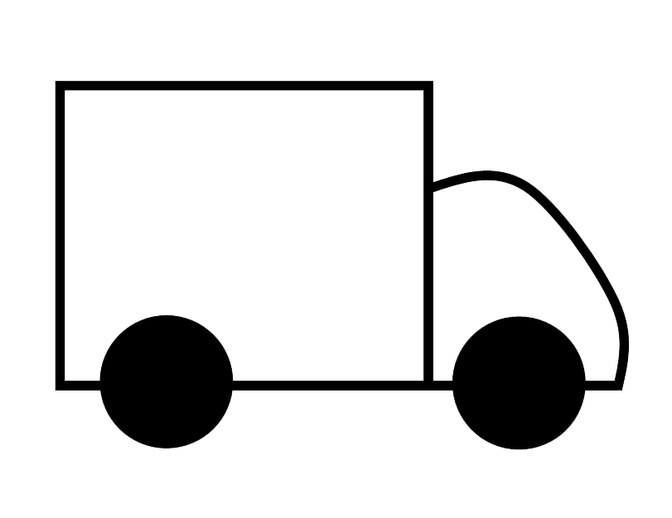

Template: DEFAULT VALUES WILL BE 00 IN NUMERIC FIELDS
Headquarters
Weekly
Daily Order
Supplier
Customer
Tue + Thu
Daily Order
Daily Order
Weekly
Order
Daily Order
1 X Daily
Total cycle time =
0.522 weeks
Total cycle time =
0.522 weeks
Total cycle time =
0.522 weeks
Total cycle time =
0.522 weeks
Step 1
Step 2
Step 3
Shipping
000
000
000
000
IPLT | 600
P/T | 0
C/O | 100
Availability | 100
Batch size | 15
IPLT | 600
P/T | 0
C/O | 100
Availability | 100
Batch size | 15
IPLT | 600
P/T | 0
C/O | 100
Availability | 100
Batch size | 15
 | 0 day
LEAD
TIME (s) | 42000
VALUE
TIME (s) | 4200
 | 0 days
 |  | 35 Seconds
 | 0 day
 | 35 Seconds
 | 0 day
 |  | 35 Seconds

Slide 2
Rule 1
Headquarters
Weekly
Daily Order
Supplier
Customer
When user adds the supplier or customer symbol, it should be linked automatically to the Headquarters (production center), with an arrow, later on user can remove the arrow or change the arrow with other types of arrows.
If user adds a supplier or customer symbol and there is no production center symbol, than app should give a message for adding a production center, and if user select yes, than add the production symbol and link that to the customer & supplier symbols.

Slide 3
Rule 2
When user adds a process box, a data box should be automatically added under that process box. User can later delete the data box later.
If user deletes a process box, app should delete its data box automatically.
If user deletes a data box, it should give a warning to user, for having a process box with out data box.
Process Name
No of Operators
CT | 30 mins
C/O | 10 mins
Shifts | 2
Availability | 30%
Batch size | 15
+

Slide 4
Rule 3
Headquarters
When user adds a process box, a data box should be automatically added under that process box and link that process box with the production control box on the top through the arrow. User can later delete the data box later.
Daily Order
Step 2
CT | 30 mins
C/O | 10 mins
Shifts | 2
Availability | 30%
Batch size | 15
+

Slide 5
Rule 3.1
Headquarters
Weekly
Daily Order
When user adds the process box for the first time, it should link it to the supplier and customer symbols automatically, and also adds the inventory symbols along with time line
Supplier
Daily Order
Customer
Step 2
CT | 30 mins
C/O | 10 mins
Shifts | 2
Availability | 30%
Batch size | 15
+
000
000
LEAD
TIME (s) | 42000
VALUE
TIME (s) | 4200
 | 0 day
 | 0 day
 |  | 35 Seconds

Slide 6
Rule 3.2
Headquarters
Weekly
Daily Order
When user adds the process box for second time, it should link it to previous box , and also update the time
Supplier
Daily Order
Customer
Daily Order
Step 1
Step 2
000
000
000
IPLT | 600
P/T | 0
C/O | 100
Availability | 100
Batch size | 15
IPLT | 600
P/T | 0
C/O | 100
Availability | 100
Batch size | 15
 | 0 day
LEAD
TIME (s) | 42000
VALUE
TIME (s) | 4200
 | 0 day
 | 35 Seconds
 | 0 day
 |  | 35 Seconds

Slide 7
Rule 4
When user adds an other process box, it should connect it to the previous process box through the arrow. Also put the inventory symbol in between. User can remove the symbol later.
Step 1
Step 2
000
IPLT | 600
P/T | 0
C/O | 100
Availability | 100
Batch size | 15
IPLT | 600
P/T | 0
C/O | 100
Availability | 100
Batch size | 15

Slide 8
Rule 5
When user adds a process box, it should also add the time line at the bottom
Step 1
IPLT | 600
P/T | 0
C/O | 100
Availability | 100
Batch size | 15
Non Value Added Time = A1+A2
Value Added Time = B1+B2
Time A2
Time

Slide 9
Rule 6
When user adds a process box, it should also add the time line at the bottom, that will be connected to the previous time line symbol. User can add the values in the time line manually, or delete the time symbol. When user adds the value in the time line, it should add the value in the total of Non Value Added or value added. Also add time symbol for the non value added time.
Step 1
Step 2
000
IPLT | 600
P/T | 0
C/O | 100
Availability | 100
Batch size | 15
IPLT | 600
P/T | 0
C/O | 100
Availability | 100
Batch size | 15
Non Value Added Time = A1+A2
Value Added Time = B1+B2
Time A2
Time A2
Time B1
Time B2

Slide 10
Headquarters
Example of rules 2, 3 & 5
Daily Order
Step 1
IPLT | 600
P/T | 0
C/O | 100
Availability | 100
Batch size | 15
Non Value Added Time = A1+A2
Value Added Time = B1+B2
Time A2
Time A
Time B

